Slide 1
2U -X Mounting Drawings

Slide 2
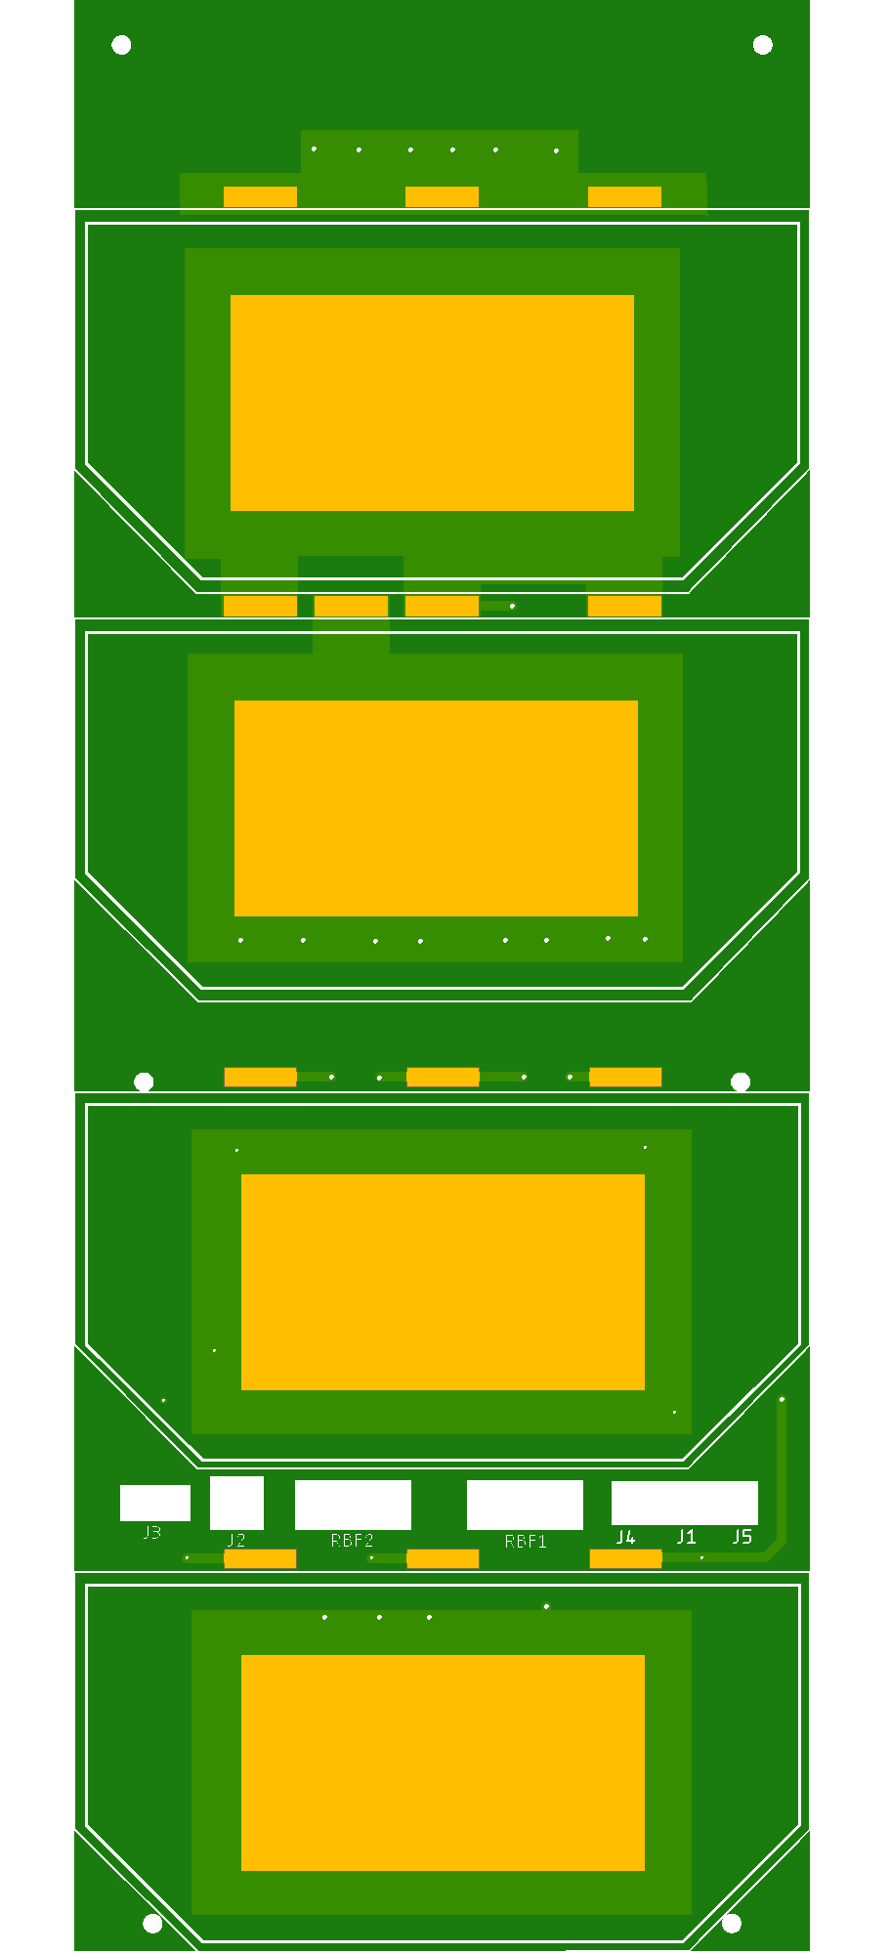
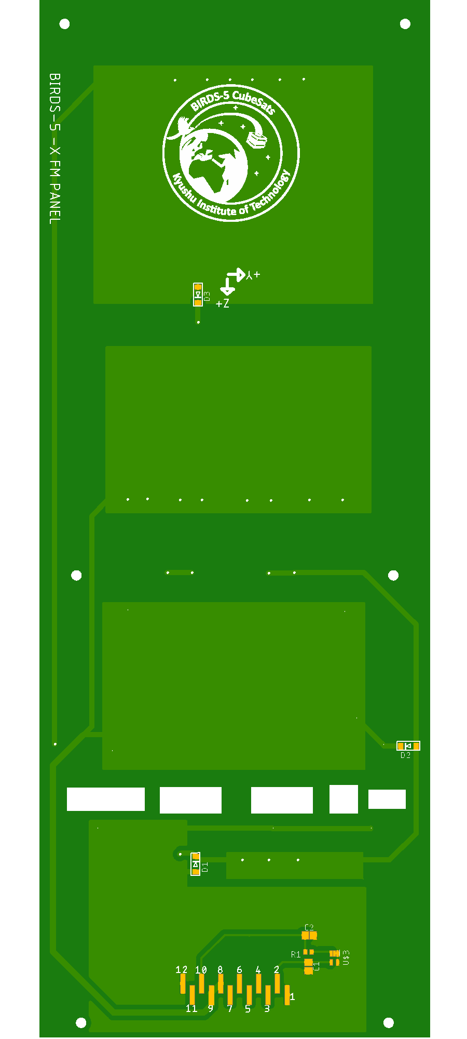
Top 3D
Bottom 3D

Slide 3


Top Components
Bottom Image

Slide 4

Bottom Solder

